Slide 1

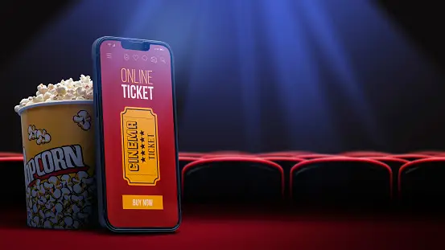
Description about Use Case-01
Presentation by:
Divyaprada G

Slide 2

AGENDA
Use Case - 01
o1. Purpose of Use Cases o6. Add Movie and Show Timings
o2. Use Case - 01 o7. Edit Movie
o3. About the Use Case - 01 o8. Movie Booking
o4. Search Movie
o5. View Movie Details

Slide 3
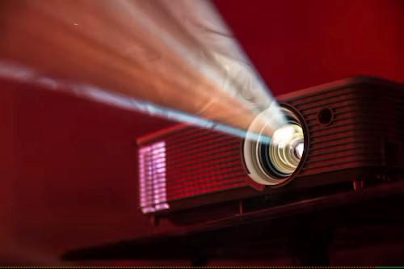
Purpose Of Use Cases
➢ Well structured use cases denote essential system or subsystem behaviour’s only, and are neither overly general nor too specific.
➢ A use case represents a functional requirement of the system as a whole.
➢ Use cases represent an external view of the system.
➢ A use case describes a set of sequences, in which each sequence represents the interaction of the things outside the system with the system itself.

Slide 4

Advantages Of An Online Movie Booking System
Customer Satisfaction - The main priority of any business is to provide customers with the very best services and to meet all their needs. An online booking platform helps a movie theatre achieve this.
Reduce Costs - A major benefit of the digital era is the way it can drastically cut costs. The business will have a system that is mostly automated which means that fewer people are needed to operate and run it. This means that the company can save on the cost of hiring multiple employees

Slide 5

3. User Friendly - Most software that developers use is not complicated to use. They make the user experience enjoyable and even the admins have an easy time updating the system.
4. Analytics - A business can easily gauge how well it is doing by going through the analytics. Data collected digitally is fairly easy to analyze. Customers can also give their feedback concerning the services which the business can take into consideration.

Slide 6
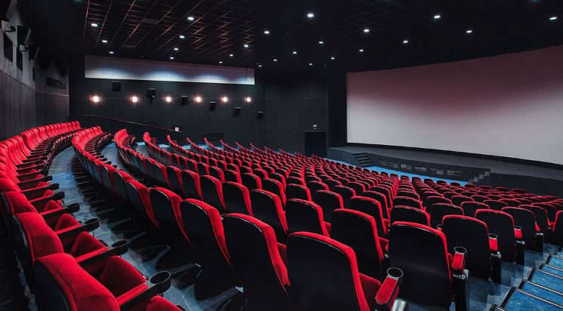
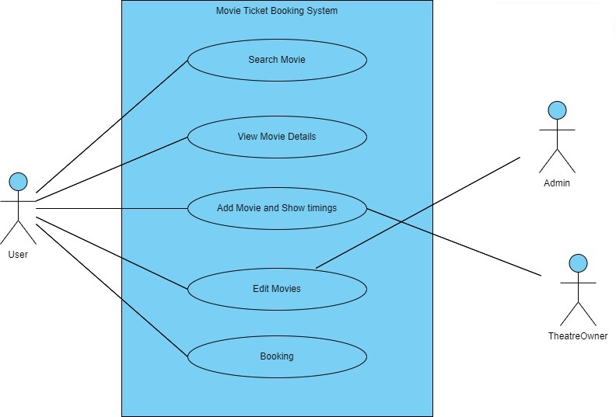
Use Case - 01

Slide 7

About the Use Case - 01
A Movie Ticket Booking System is a software application designed to allow users to book movie tickets online. The platform offers a range of features and functionalities to help users search for movies, view movie details, select seats, pay for tickets, and cancel bookings.
The use case diagram for the platform helps to identify the key interactions between the user and the system.

Slide 8


Search movie
Search Movie is a use case that enables users to search for movies based on specific criteria such as location, genre, language, and show timings.
The system should provide users with a list of available movies based on their search criteria.
Once a user selects a movie, they can view movie details and show timings for that movie.

Slide 9

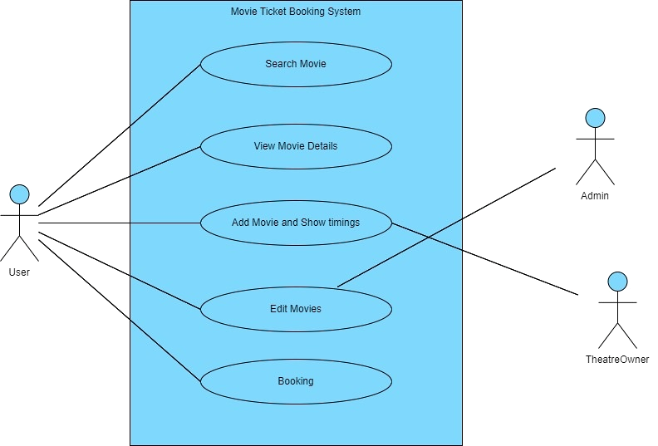
View Movie Details
View Movie Details is another use case that enables users to view detailed information about a specific movie, such as the plot, cast, director, and ratings.
This use case is essential in helping users make informed decisions about which movie to watch and ensuring that they have a good experience.

Slide 10


Add Movie and Show Timings
The Theatre Owner adds details of a new film. Film details include Title, Age Rating, Duration, and short trailer description.
The Theatre Owner adds details of a new showing of a film. Showing details include the date and time of the showing. (Showing details must also be able to record the number of tickets sold against the showing at any time).

Slide 11

Edit MOvie
The Admin can Edit or modify movie details such as title, description, genre, duration, and rating. The Admin can also set the show times for each movie and manage the available seats for each show.
Admin can manage the show venues, such as the listed cinema theatres and filter them by the venue, location, date, show-time, price range, etc.
The admin may prefer to add a cinema or remove or edit besides adding new venues.

Slide 12


Movie Booking
Movie booking is a use case that enables users to book for movies based on specific criteria such as location, genre, language, and show timings.
Once a user selects a movie, they can view movie details and show timings for that movie.
Customer can read the movie details and Book the movie ticket.
Finally received the Ticket booking verification mail/SMS.

Slide 13

The End
Thank You

